Slide 1



Introduction to R and RStudio
Session 3: Importing data

Slide 2
Import data to R
There are R packages to import all types of data. In this course, we’ll cover the most common imports: csvs and Excel workbooks.

Slide 3
Import data to R
We’d like to import the capacity_ae.csv file.
While we could write code from scratch to do this, it’s often easier to get the import wizard to do this for you.

Slide 4
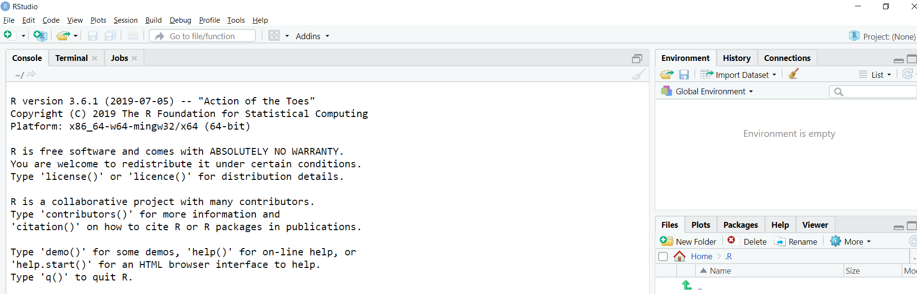
Import data to R
We will use the “Import Dataset” button:

Slide 5
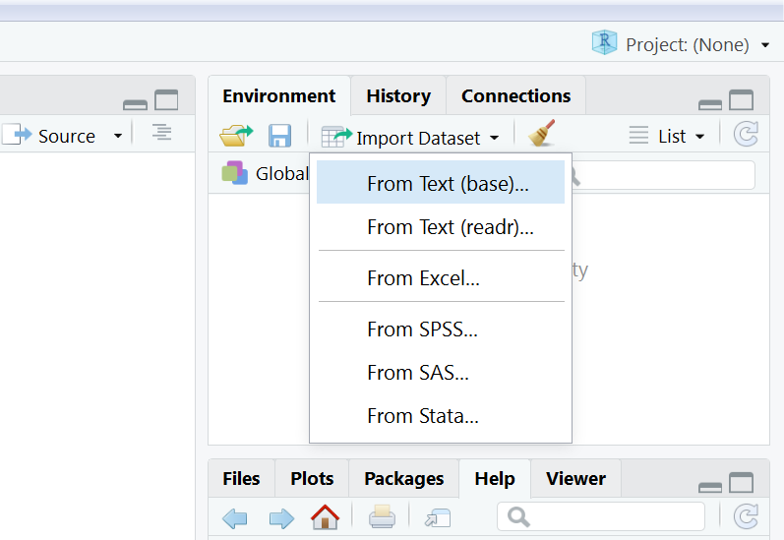
Import data to R
We will use the “Import Dataset” button:

Slide 6
Import data to R
We will use the “Import Dataset” button:
for csv

Slide 7
Import data to R
We will use the “Import Dataset” button:
for csv
for Excel
workbooks
(would require package: readxl)

Slide 8
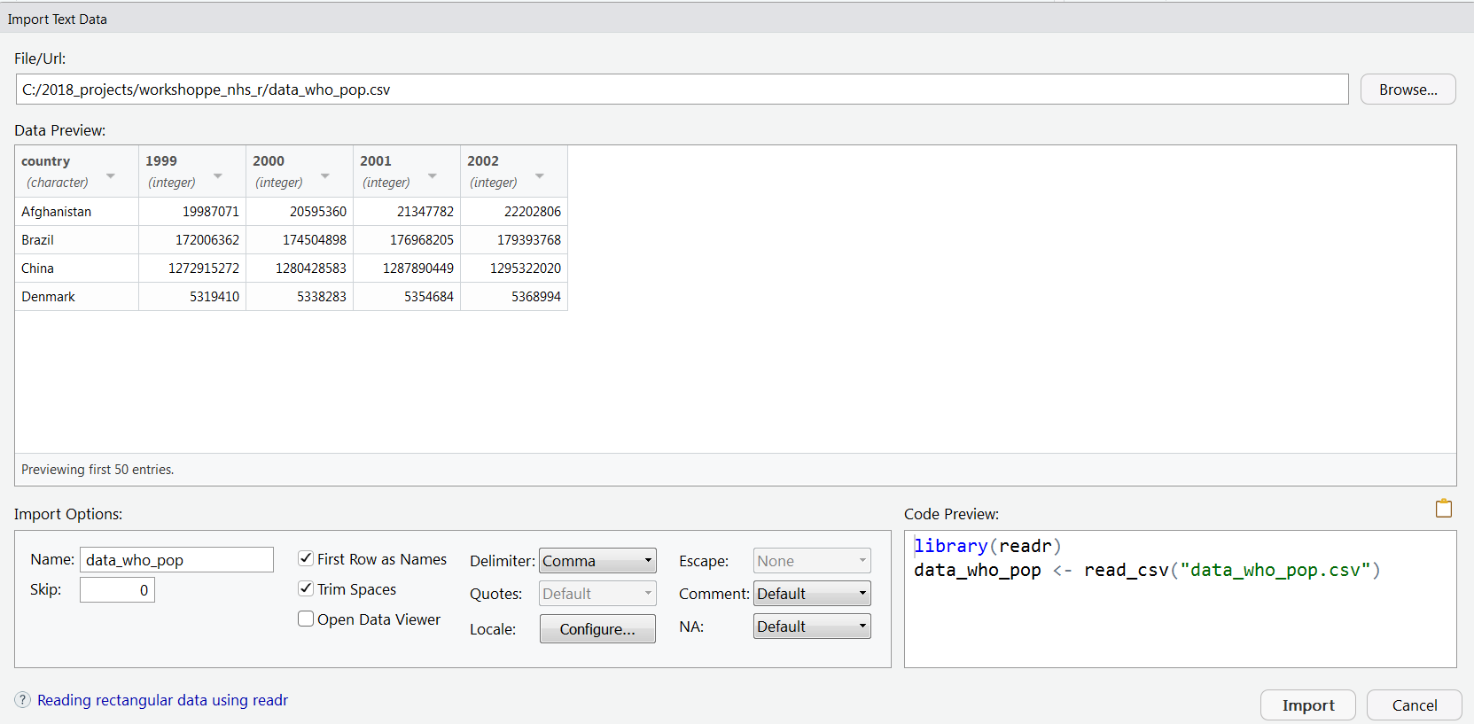
Import wizard

Slide 9
Import wizard
1.Locate the file
capacity_ae.csv

Slide 10
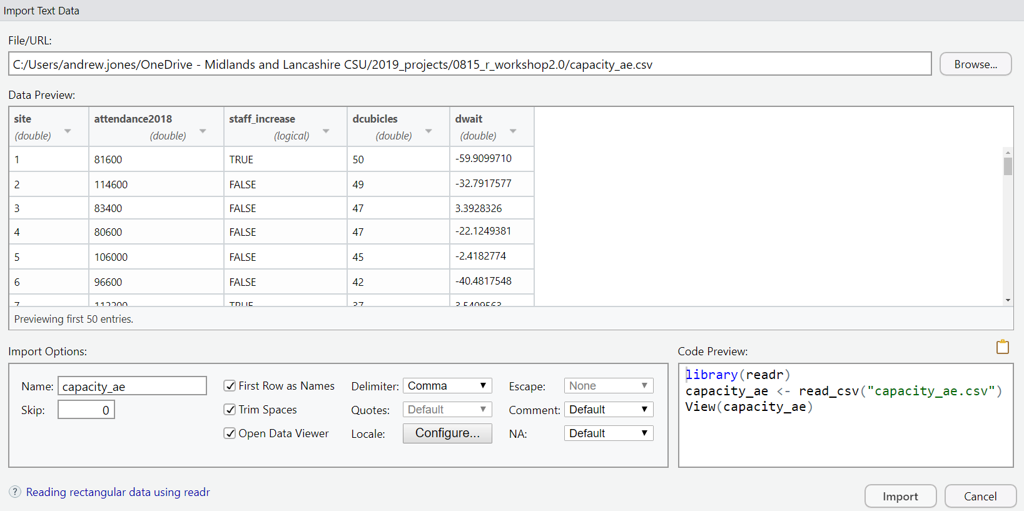
Import wizard
1.Locate the file
2. Does the preview look reasonable?
(i.e. dimensions and column names)

Slide 11
Import wizard
NOT what we want

Slide 12
Import wizard
Instead, we’d like to copy this line of code to the editor
…ready for next time we run the analysis

Slide 13
Import wizard
1.Locate the file
2. Does the preview look reasonable?
3. Highlight this line and copy

Slide 14
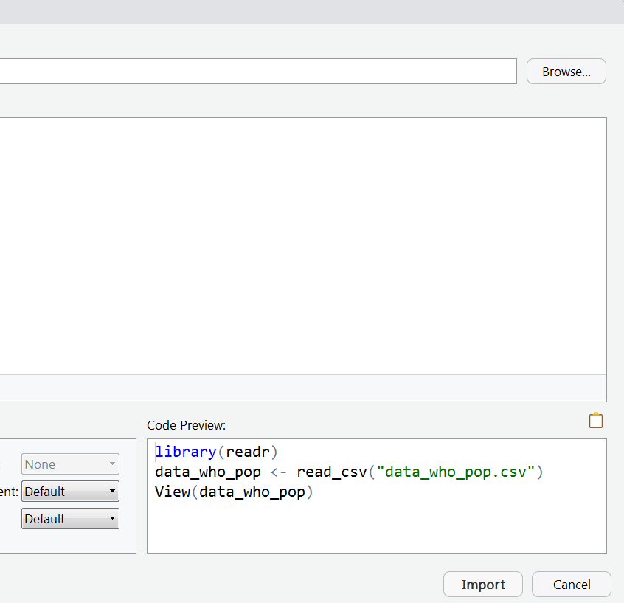
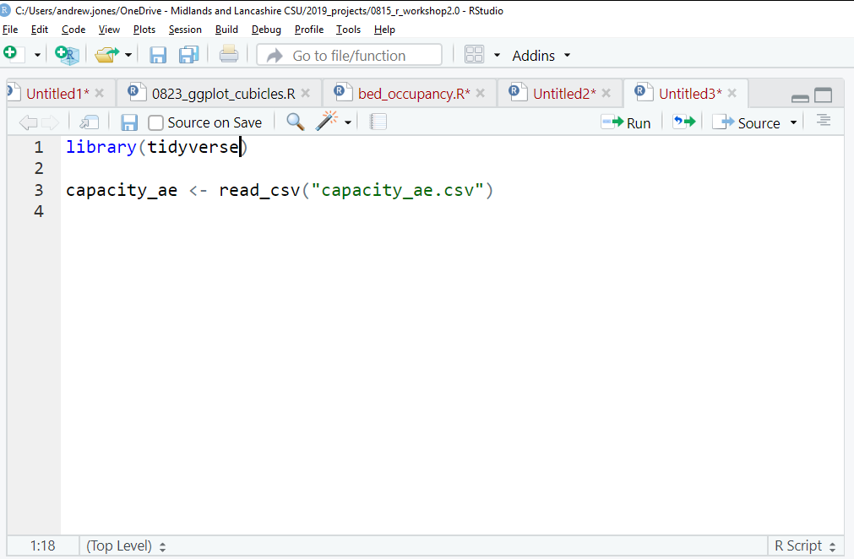
Import wizard
4. We now “cancel” the import wizard
5. And Paste the code into the editor
window
6. Finally, run the code from the editor
(Ctrl + Enter)

Slide 15
This material was created for the NHS-R community by:
Andrew Jones @The Strategy Unit
The work is licenced under:
Creative Commons
Attribution-ShareAlike 4.0
International
To view a copy of this license, visit
https://creativecommons.org/licenses/by-sa/4.0/

Slide 16
End

